Slide 1
Mini Project -II
Best Hotel Deals - Bharattrotter Website
Presented By:
Kratika Motwani (16BCE095)
Tanya Motwani (16BCE096)

Slide 2
Introduction
Bharattrotter is a hotel search engine, which provides best hotel deals for users.
This search tool scans hotel booking database for prices, availability, images and reviews within seconds. When a user chooses a hotel, details about its deals like inclusions, description are displayed.
Users are further directed to a partner website to complete the booking. Also they can create accounts and access all the content available on the website.

Slide 3
Motivation
Convenience is the prime reason for development of this project. Tedious task of choosing the best hotels is made easy.
This website also helps you get last minute deals, comparing different hotel prices, and allows you to search hotels according to various filters with just one click.
The great thing about this website is the quality of experience it delivers, its easy accessibility and beautiful layout which makes user experience delightful.

Slide 4
Survey
Online websites like MakeMyTrip and Trivago facilitate searching through different websites for best hotel deals. So, they were taken as a reference. These websites have several features, some of them are listed below:
Hotel Search Engine
Simple Layout and Description of hotel deals
Deals are categorized through filters and can be accessed easily
Rating index is provided.
User Accounts

Slide 5
Functionalities
Security : Privacy is maintained through personal accounts which can be accessed via Email id and a Password.
Accessibility : The hotel deals are easily extracted through filters like price, rating, location, facilities, etc.
Maintenance of database : The database is regularly updated to enable extraction of different hotel deals and their descriptions.
Suggestor- It displays the top destinations and hotels of the month.
Communication- Direct link to the hotel website is given through which a user can complete the further booking process easily.

Slide 6
System Requirement Specifications
Operating System Requirements: Windows 7 (64 bit, x64 based processor)
Software Requirements: Any text editor, Any browser, WAMP, PHPMyMailer
Hardware Requirements: Intel(R)Core(TM) i5-4200U,1.60Ghz 2.30Ghz, 6Gb RAM
Languages Used
HTML, CSS, Java Script, Bootstrap, PHP
SQL- Database Management

Slide 7
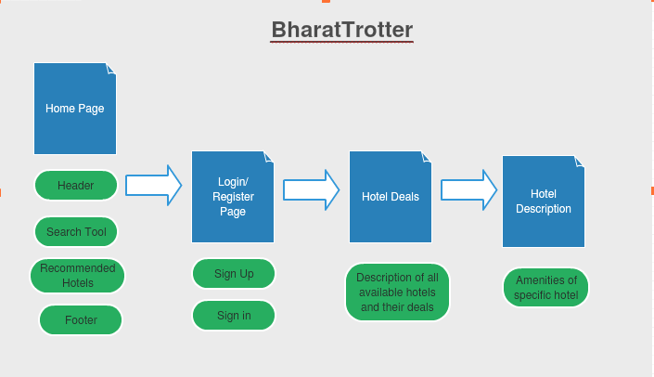
Site Map

Slide 8
Description
Page 1 (Home Page – Bharattrotter.html)
The Header of Home Page consists of
Home
About
Contact
Login / Register
The user is asked to enter the Location, Check In Date, Check Out Date and Number of Guests. On clicking the find hotels option, the user is directed to the next page where the hotel deals and hotels of that location are displayed.

Slide 9
The homepage displays various recommendations of popular destinations to attract users.
For users who want Luxurious Hotels, the home page also provides many options for them to choose from.
The Footer of the home page comprises of following options:
News Letter – The user can subscribe to our page through this option. He/She will be regularly updated with the best hotel deals available.
Contact Information

Slide 10
Page 2 (Login/Register Page.html)
When user selects the option of Login/Register on home page, he is directed to the login page.
It provides 2 options - to either login if you already have an account or register if you want to create an account.
Various validations are applied for security and, to check correctness of data on both login and register pages.

Slide 11
The Register page is redirected to the Login page. The information of the registered users is inserted into a database, which is checked every time a user wants to login.
On the Login Page, there is also an option of Forget Password. If the user doesn’t remember his/her password, on clicking this option, an email is sent to the user’s email ID which contains his/her original password.

Slide 12
Page 3(Contact.html)
The user can contact us in case of suggestions, recommendations and queries using the contact.html. Further communication between us and the user will be done using mail.
Page 4 ( About.html )
About.html contains basic information about our website, so that the user gets acquainted about its working and history.

Slide 13
Page 5 (Hotel.html)
This page consists of list of all the hotels based on the location that the user had provided on the main page.
The name, image, description of the hotels, their price, rating and location are displayed.
On this page, various filters are available for the user like city, location, price, rating, and different facilities that are provided by the hotels. This makes it convenient and easy for the user to search through the hotels and choose the best hotel for him/her.

Slide 14
Page 6 (Hotel Description Page - HotelDeals.html)
When a user selects any hotel option, he is directed to the Hotel Description page where all the amenities provided by the hotel, its detailed description, images and different hotel deals are displayed using a sliding window.
If the user wants to book a hotel, he is further redirected to the hotel’s website.

Slide 15
Future Improvisations
The following features can be further included in the website:
The user interface of the application can be improved. Other filters can be added with sort options.
The database used is static in the project. We can include real time database which will increase the speed of processing, and make it dynamic.
The reloading time of pages can be improved using Ajax.
The website is developed locally and cannot be accessible via web or other devices. So, it can be further hosted on the web server. It can also be turned into an applicaton.

Slide 16
Conclusion
Bharattrotter was made keeping in mind the convenience of travelers across India as well as the rest of the world. It outputs various available hotels, based on the user input. It’s user friendliness and the simplicity, as well as efficiency allows users to easily and quickly access the information they require. There is timely communication between the hotel and our website subject to price change and availability. Using this project, we learnt about the everyday consumer requirements and how it can be achieved using a simple website.

Slide 17
References
W3Schools
YouTube
Beginnersbook.com – HTML/CSS/ JavaScript Tutorials
TutorialsPoint.com
Stack Overflow

